Slide 1
Unlocking Marketing Intelligence with AI Transformations in Fabric
Dennes Torres

Slide 2
Agenda
A sample project
Shortcut Transformation
Shortcut AI Transformation
Materialized Lake View

Slide 3
The Problem we are Solving

Slide 4
The Problems We are Solving
Low Code Medallion Architecture
AI Implementation in a pipeline

Slide 5
Sample Solution: Amazon Product Reviews

Slide 6
Amazon Sample Solution
Records in CSV format
Each CSV has 500 records
Records has multiple columns
One column contains the product review

Slide 7


Tables
Amazon
Shortcut Transformation

Slide 8
What’s Shortcut Transformation

Slide 9
Shortcut Transformation
Transforms the source content in a different format
Supported today: CSV -> Delta
Refresh Rate: 2 minutes
Column Names are Required – For Now

Slide 10
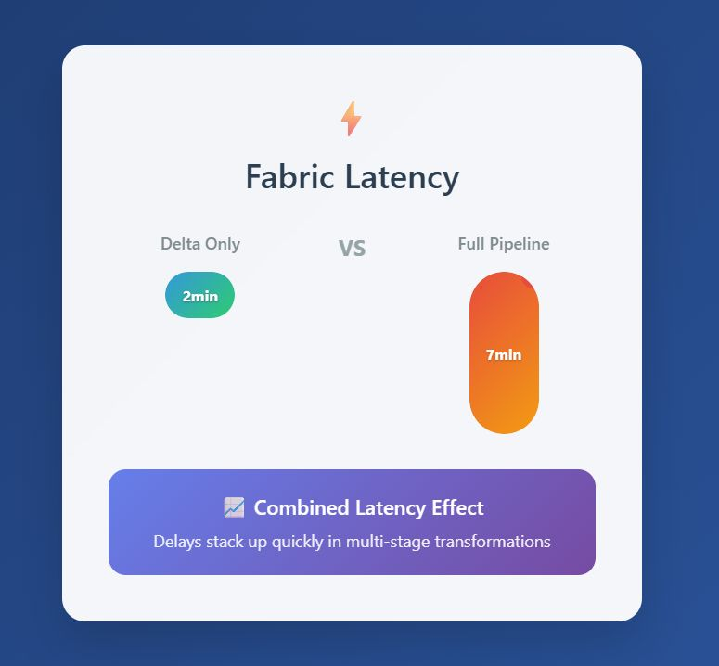

When to Use
No Transformation, only
conversion
Transformation and conversion

Slide 11
Shortcut Transformation

Slide 12
What’s Shortcut AI Transformation

Slide 13
Shortcut AI Transformation
Works over TXT files
Intended to transform TEXT according to the AI model
One file for each source record
Each file can generate multiple destination records
The result is a Delta Table

Slide 14
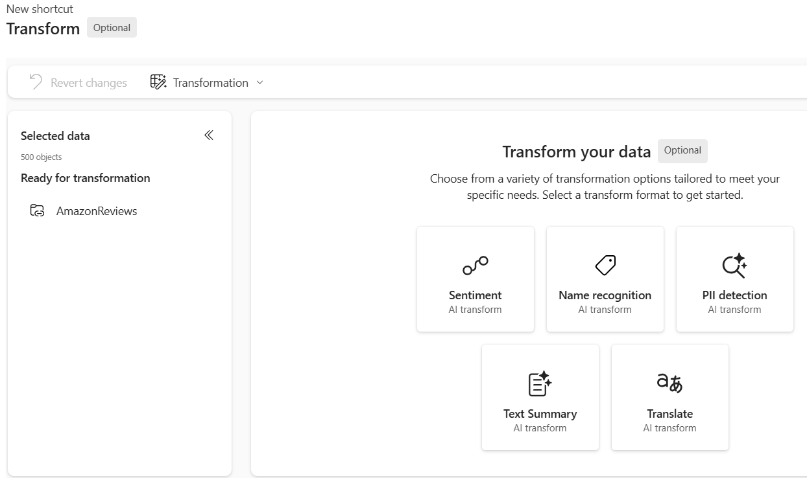
Available Transformations

Slide 15
How to process AI Transformations over a field in the Delta Table?

Slide 16
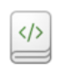
Tables
Amazon
Shortcut Transformation
ControlId
Files
AmazonReviews

Slide 17
Generating Files for AI Transformation

Slide 18
Tables
Amazon
Shortcut Transformation
ControlId
AmazonReviews
Shortcut AI
Transformation
Files
AmazonReviews

Slide 19
Creating the AI Transformation Shortcut

Slide 20
AI Transformation Resulting Table

Slide 21
Sentiment Analysis Rating
3 Numeric Fields: Positive, Negative and Neutral confidence
The values vary from 0 to 1 (percentage of confidence)
The SUM of the 3 fields is always 1
These fields define the value of the field Sentiment

Slide 22
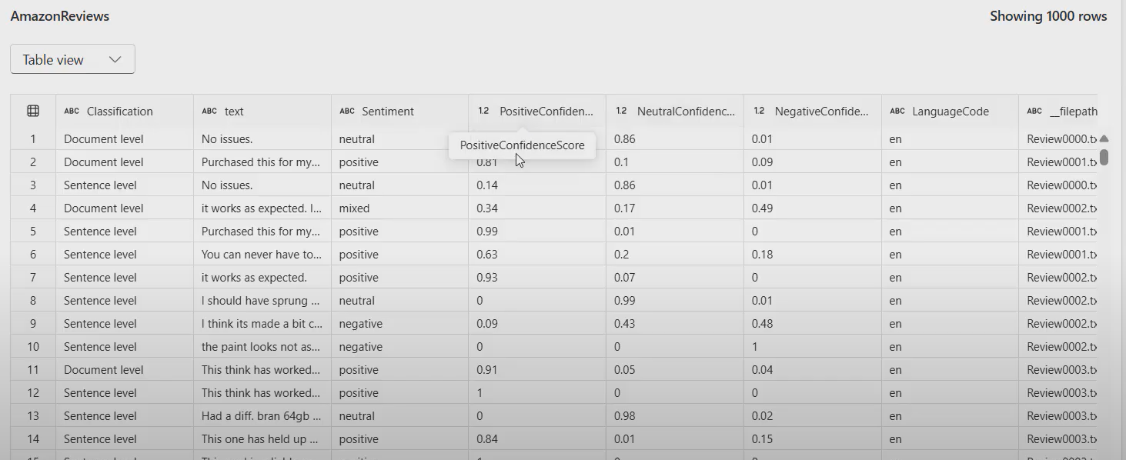
Sentiment Confidence

Slide 23
Sentiment Field
Values: Positive, Negative, Neutral, Mixed
The confidence above 50% define this field
If no one is above 50%, the value is Mixed
Use this field for a simplified analysis
Dig into the numbers for a detailed analysis

Slide 24
Classification Field
Document Level or Sentence Level
Each file results in multiple records
One record for the document level
One record for each sentence in the text
You can use the Document Level and ignore the rest
You can make a deeper analysis with Sentence Level

Slide 25
Tables
Amazon
Shortcut Transformation
ControlId
AmazonReviews
Shortcut AI
Transformation
AmazonSentiment
Files
AmazonReviews

Slide 26
Analysing the AI Result

Slide 27
Materialized Lake Views

Slide 28
Materialized Lake Views
Transformations using queries
Scheduled Transformations, not automatic
Only available with schema support
It remakes the entire view

Slide 29
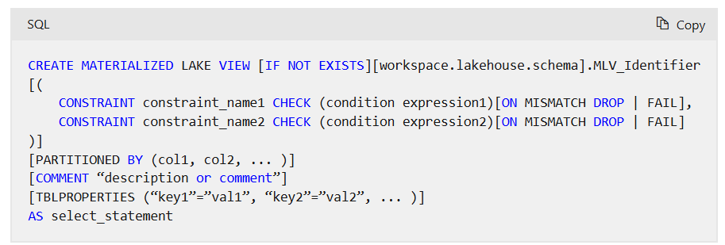
Materialized Lake View

Slide 30
Creating the Materialized View

Slide 31







Dennes Torres Data Platform MVP (Alumni)
Dtower Software
https://dtowersoftware.com
Trainer
MCT, Azure Solutions Architect, Azure Data Engineer and Azure DevOps Engineer
Malta Data Platform UG Leader
Malta
MMDPUG
https://www.facebook.com/MMDPUG
http://dennestorres.com
Dennes.Torres
@Dennes
https://br.linkedin.com/in/dennestorres
dennes@bufaloinfo.com.br
http://youtube.com/c/dennestorres

Slide 32








Fabric Community
Facebook Page
Facebook Group
WhatsApp
Meetup
LinkedIn
Youtube
Twitter

